Slide 1

The Healthy Dancer Unit - CATS Swindon Ballet and Contemporary Cohort 2024/2025
Tutor for the Unit : Mr Owen Morris
Professional Ballet Dancer, Ballet Teacher,
Pilates Teacher, Rehabilitation Teacher for Dancers
A Guide for Young Dancers

Slide 2
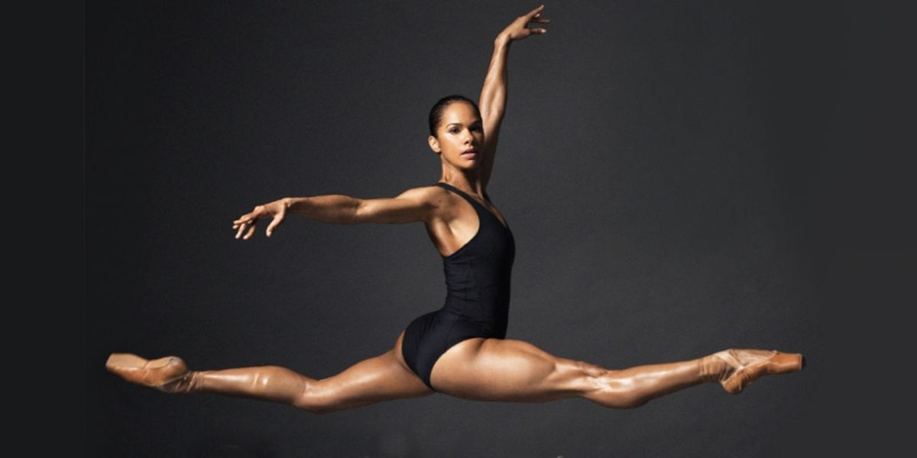
Caring for your body: Nutrition, injury Prevention and longevity in dance in pairs, please discuss what this means to you and why this is so important as dancers !
Leutwyler, 2017

Slide 3
Brief Overview of the importance of body care for dancers
Body care is crucial for dancers, as it impacts their overall performance, health and longevity in their training and careers. Here are some key points highlighting its significance:
Injury Prevention – Dancers are prone to injuries due to the physical load the art form demands and expects. Proper body care, including warm-ups, cool downs, and cross training i.e. Pilates, Gyrotonics, Strength & Conditioning, Yoga, Swimming, Skipping, Light jogging will help reduce the risk of injuries and allow dancers to perform at their very best.
Physical Health- Regular care of the body requires routines such as stretching, keeping well hydrated, eating well and keeping the body nourished can contribute to overall physical wellbeing. A healthy body supports better quality in movement and increased endurance in your training, rehearsals, classwork and performances.
Recovery – Dancers will often experience fatigue and soreness in the body. Applying recovering such as sport massage, rest, proper sleep, and nutrition can help heal and help dancers maintain high levels of performance.
Alignment and Posture – Dancer tailored body care routines can promote proper posture and alignments which are important for both preventing injuries and aesthetically how a dancer presents themselves technically and on stage. This focus helps to maintain flexibility and strength in a well-balanced way.
Mental Health – Body care can expand beyond the physical side of things to mental wellbeing. Practicing things like mindfulness, breathing exercises and meditation as well as seeking advise from Performance Psychologists, Counsellor's and Mental Health First aiders can help dancers manage the pressures of the art form and contribute to a healthy positive mindset.
Longevity in careers – By engaging in body care, dancers extend their careers and have long, happy successful careers at the top. Establishing healthy habits in the formative years of your training can lead to sustainability allowing dancers to performance into their later years adapting and modifying as their bodies change and you experience life.

Slide 4

Task
Write down on a piece of paper what things you already do as dancers in training for your physical and mental health.
For example:
- I cool-down after class
- I do calm breath work before I go on stage

Slide 5
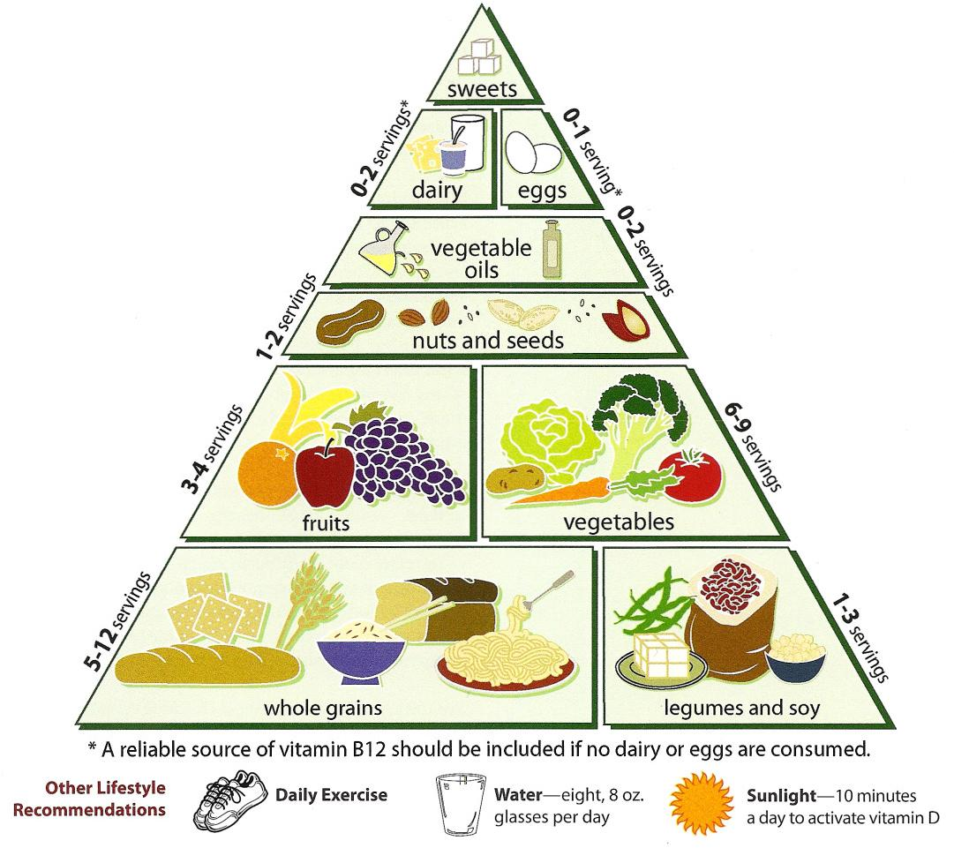
Nutrition for dancers
Why is it important for dancers to maintain good nutritional habits ?
Give me your thoughts on this ☺
This Photo by Unknown Author is licensed under CC BY-SA

Slide 6
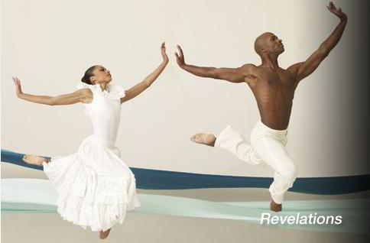
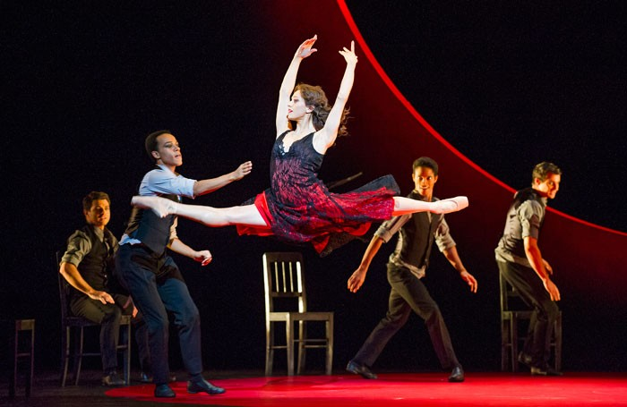
Nutrition is crucial for dancers to maintain performance, energy and recovery. A well-balanced diet should include:
Carbohydrates – The primary energy source, essential for stamina levels. Foods include whole grains such as rice and cous cous, pasta, potatoes, fruits and vegetables.
Proteins – Vital for muscle repair and growth. Sources include meat, fish, dairy, nuts, beans, pulses and seeds. Also, magnesium supplements for body recovery (always have with food)
Fats – Necessary for long-term energy and hormone building. Healthy fats otherwise known as monounsaturated fats include olive oil, avocados, nuts. Not so good fats otherwise known as trans-fat can be found in processed food such as crisps, chocolate, sweets, heavy dairy and fast food. That is not to say you can’t have bad fats. Everything is fine in moderation, and we are all entitled to eat chocolate, sweets, cake, cheese and the occasional fast food as long as we keep eating a balanced diet.
Vitamins and Minerals – These support your immune system and overall health. A variety of vegetables and fruit in your day-to-day diet can help meet these needs.
Hydration – Staying hydrated is key to keeping performance high. Water is essential to life it keeps us alive and helps use maintain a stable body temperature during exercise. It supports digestion and absorption of nutrients and improves performance, prevents fatigue and muscle recovery. Electrolyte tablets can be used in water to help maintain hydrations levels and salt intake during intense training or on a hot day.
This Photo by Unknown Author is licensed under CC BY-NC-ND
This Photo by Unknown Author is licensed under CC BY-NC

Slide 7
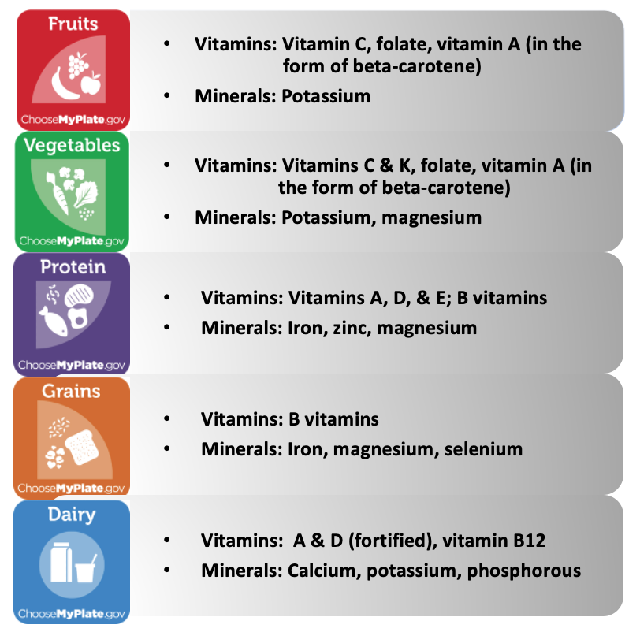
Vitamins and minerals
Vitamin C is great for improving immune system, aiding in collagen synthesis. It also helps maintain flexible joints and connective tissues which can prevent injury.
Vitamin D is vital for bone health and muscle function and for calcium absorption. It can improve muscle strength and reduce risk of fractures. Vitamin D can also be associated with the sunshine, as it supports overall health and improve and energy levels. When we in in the sun we absorb Vitamin D from the sunlight which in small doses is great. Avoid spending to long under the sun as it can be damaging for the skin if not protected by suncream. During the winter months Vitamin D is recommended to take eating foods with more vitamin D and or Vitamin D supplements, especially when there is less sunlight.
Magnesium is important for muscle relaxation and producing energy. It can help prevent cramps and spasms. This allow dancers to perform with great endurance and reduced tiredness.
Zinc supports immune system, protein synthesis and wound healing. It can help maintain healthy skin and aids muscle repair and recovery.
Omega 3 can be found in fish as well as seeds and walnuts and is great for hearth health, reduced blood pressure, brain function, inflammation reduction and eye health.
This Photo by Unknown Author is licensed under CC BY-NC

Slide 8
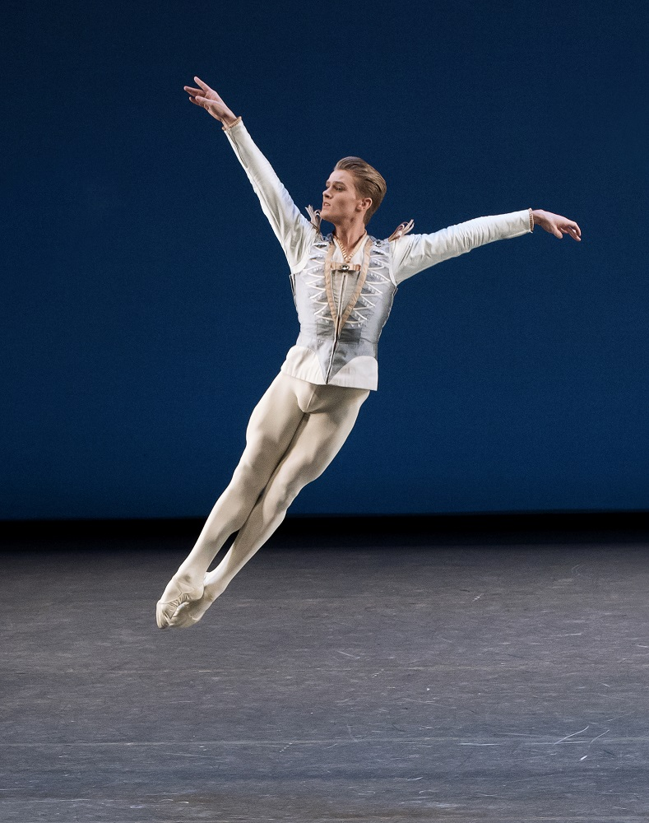
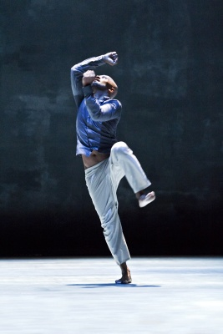
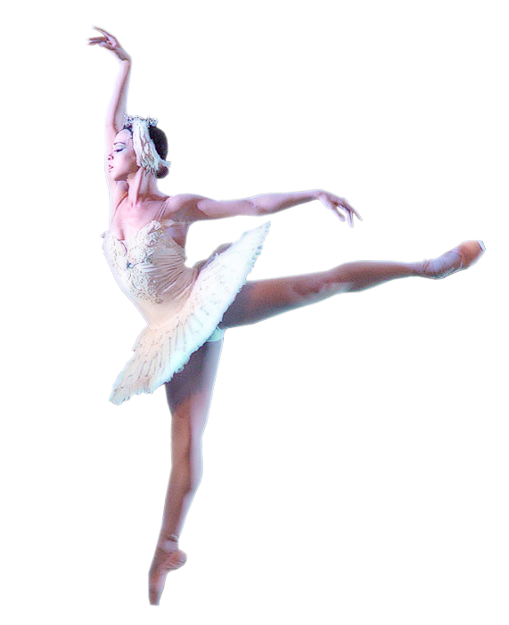
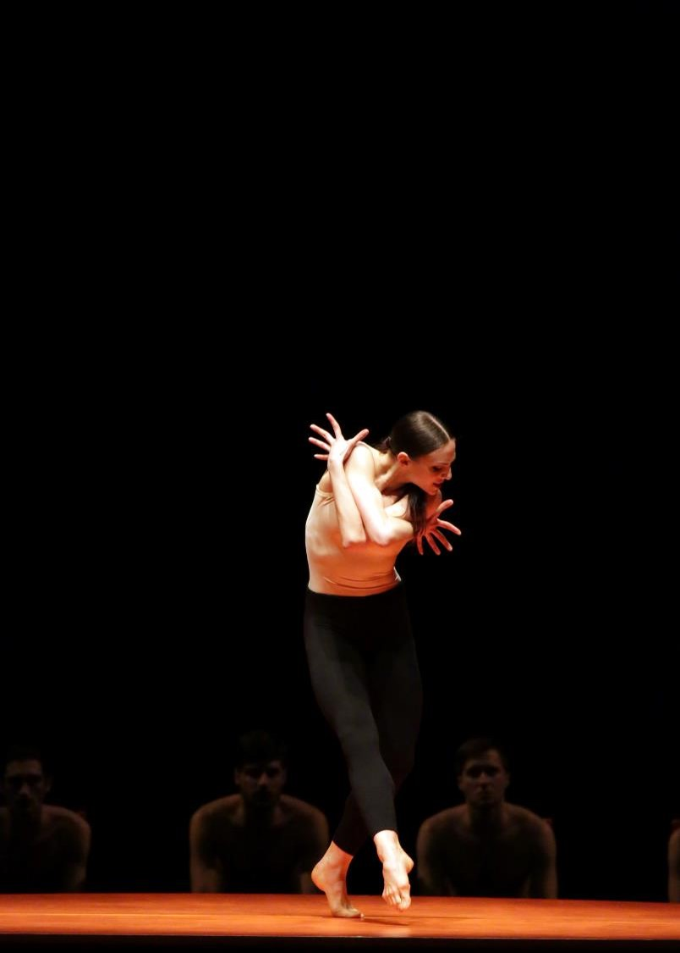
Nutrition tips for dancers
Breakfast ideas for dancers
Porridge with things such as sliced banana, berries, drizzle honey, nuts on top.
Scrambled Eggs on Toast with things such as spinach and tomatoes and brown bread. For vegans' tofu scramble with whole grain toast or mix chia seeds with almond milk and fruits and nuts on top in the morning.
Lunch Ideas for dancers
Wraps with things such hummus, salad, tofu etc.
Pasta Salad with protein source and salad.
Soup with protein source and brown bread/roll.
Dinner Ideas for Dancers
Pasta with veg and protein source TREAT YOURSELF TO A TREAT AFTER DINNER
Potatoes or rice dish with veg and protein source
This Photo by Unknown Author is licensed under CC BY-NC-ND
This Photo by Unknown Author is licensed under CC BY
known
This Photo by Unknown Author is licensed under CC BY-NC
This Photo by Unknown Author is licensed under CC BY-SA-NC

Slide 9
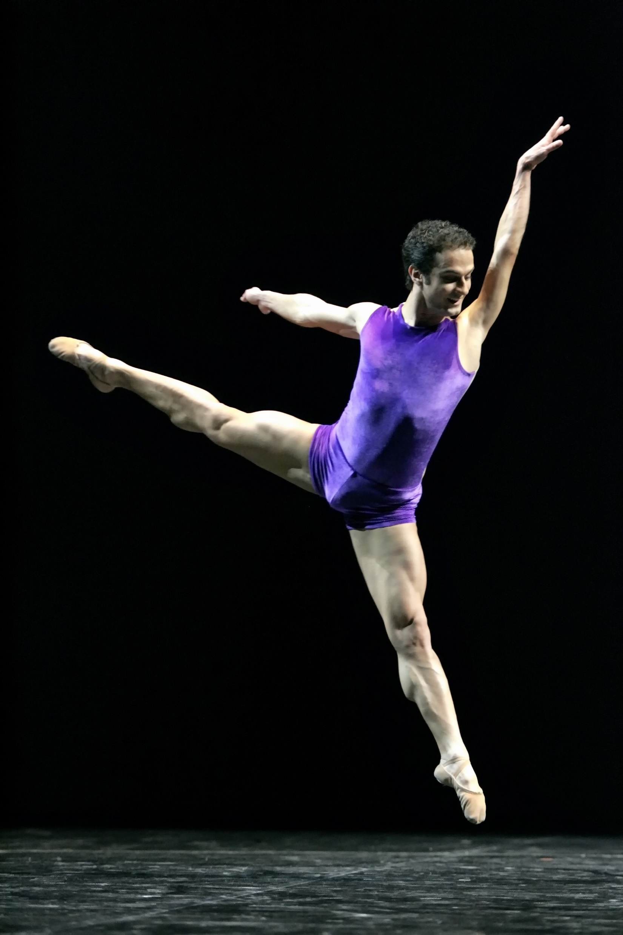
Snack and hydration ideas
AS DANCERS ARE OFTEN TRAINING REHEARSING AND PERFORMING FOR MANY HOURS DANCERS SHOULD CONTINUALLY SNACK AND STAYED HYDRATED. SNACK IDEAS FOR DANCERS INCLUDE:
- Nuts, Dried Fruit, Seeds, Apple Slices, Hummous dipped with carrot sticks, bread sticks, cucumber slices, peppers.
- Rice Cakes with avocado, Energy Balls, Protein Balls, Protein Bars, Greek Yoghurt, Bananas, and Oat Biscuits.
- Dancers should maintain high levels of hydration throughout the day sipping water every 15-20 minutes depending on the intensity of the work the dancer is doing. Add an electrolyte tablet into a bottle on a extremely hot day or if the training load is extremely intense.
LET ME KNOW WHAT SORT OF THINGS YOU EAT TO MAINTAIN YOUR PERFORMANCE LEVEL AS A DANCER IN TRAINING !?

Slide 10

Injury prevention
TALK WITH A DIFFERENT PERSON ABOUT INJURY PREVENTION AND WHAT YOU DO FOR YOUR OWN INJURY PREVENTION AND WHAT YOU KNOW ABOUT INJURY PREVENTION !!
WRITE DOWN YOUR IDEAS AND THEN ONE MEMBER OF THE PAIR CAN DELIVER THE ANSWERS TO THE CLASS ☺
This Photo by Unknown Author is licensed under CC BY-SA-NC

Slide 11
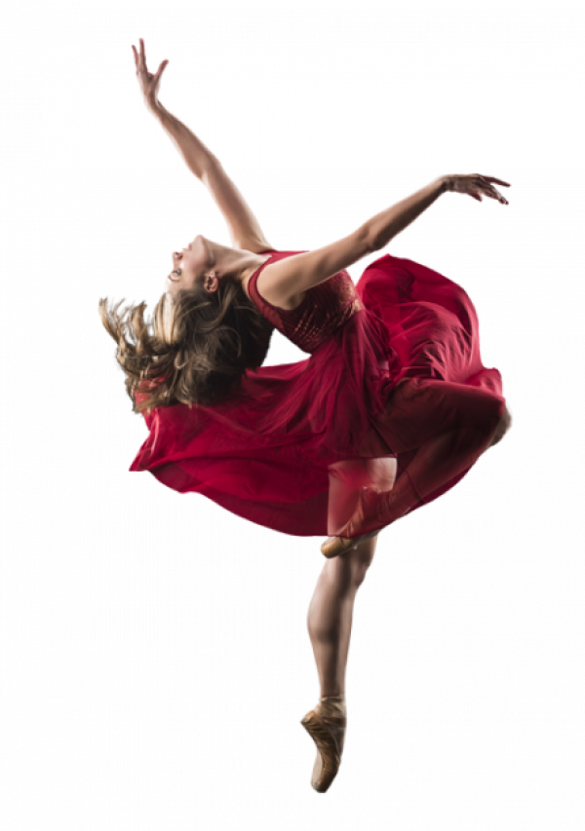
Injury Prevention
Injury prevention for dancers is vital in maintaining peak performance and longevity in their careers for example:
Understanding common injuries in dancers such as ankle sprains, Achilles tendonitis, knee injuries, hip injuries, stress fractures, shin splints, back pain and plantar fasciitis.
Importance of correct and safe technique and alignment is vital in minimising risk of injuries occurring. Dancers should always use correct posture and alignment during all movements to prevent added stress on muscles and joints.
How to prevent injury includes: Regular strength training outside of dance classes/rehearsals such as regular Pilates Sessions, Progressing Ballet Technique, Strength & Conditioning in the gym which will help maintain muscle strength, length, endurance and stability and make the body more resilient.
Flexibility exercises are important for dancers to do everyday to increase range of motion in the body allowing the body more space to hit certain positions and movements and it helps prevent tightness in the muscles which can often lead to injuries if not addressed.
Cardiovascular Training is important to keep overall fitness and stamina. Building stamina in class and rehearsals will be the main way but doing activities such as swimming provide low-impact cardio training improving fitness and stamina. Also skipping, power walking and light jogging.
In conclusion by focusing on these specific points, dancers can lower their risk of injury and enhance their overall performance on stage, in rehearsal and in their technique classes.
This Photo by Unknown Author is licensed under CC BY-NC

Slide 12
Let’s get up on our feet and let's learn some Pilates/strength & conditioning exercises and some stretching
Let’s get learning ☺

Slide 13
Warming up and Cooling down create two columns. write in one column why we should warm-up and in the other why we should cool down and then throw your ideas to me ☺
Why should we warm up ?
Why should we cool down ?

Slide 14
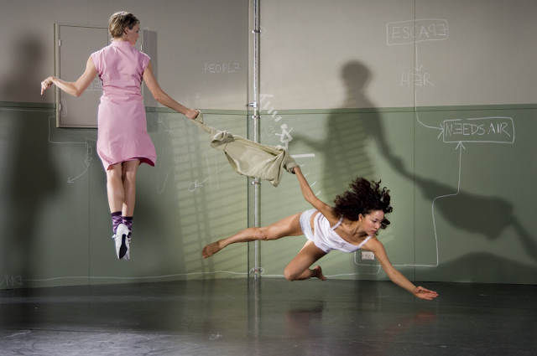
the importance of warming up
Warming up is important for dancers due to the physical intensity the art form requires. Here are some key reasons for warming up:
Muscle Activations – Warming up activates the right muscle groups used to dance ensuring they are reading for the movements involved.
Injury Prevention – A proper warm-up helps to reduce the possibility of sprains and strains by preparing the muscles and joints correctly.
Enhanced Performance – A good warm-up can lead to a better performance as it increases muscle temperature and blood flow, allowing for more control and precision in the movements and overall performance.
Mental Preparation – Allows dancers to mentally prepare for the task ahead, helping them focus and get into a professional mindset.
Coordination and Balance – Helps to improve coordination and balance.
Increase in Heart Rate. It gradually raises the heart rate, reducing the risk of cardiovascular strains and or ensuring the dancers can dance at their highest potential.
IN SUMMARY INCORPORATING COMPREHENSIVE WARM-UPS IS ESSENTIAL FOR DANCERS TO MAINTAIN THEIR OVERALL HEALTH, ENHANCE PERFORMANCE, TECHNIQUE AND AVOID CHANCE OF INJURY.
This Photo by Unknown Author is licensed under CC BY-NC

Slide 15
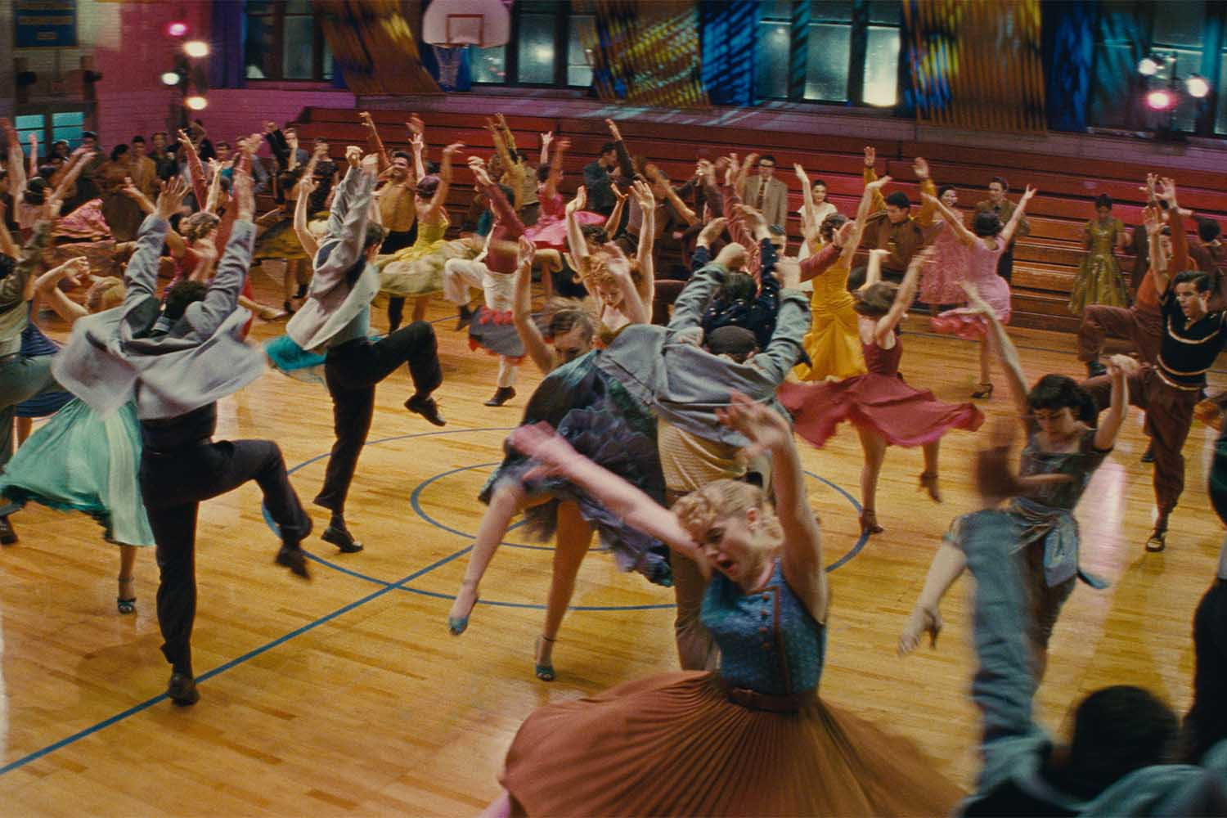
The importance of cooling down
Cooling Down is crucial part of a dancer everyday life, and its importance cannot be overplayed. Here are reasons why cooling down is crucial:
Muscle Recovery – Helps bring down the heart rate and allows blood to the muscles, which helps in the removal of waste products such as lactic acid. This can help prevent stiffness and soreness in the muscles.
Flexibility – Gentles stretches during the cool-down can increase flexibility and maintain range of movement.
Injury Prevention – Can help reduce the chance of injuries by reducing tension in the body and drawing attention to proper body alignment. This is important for dancers who put themselves physically through a lot of stress in class, rehearsals and performances.
Mental Transition – Provides a moment of calm from the intense work dancers do bringing them to a more relaxed state of mind. This can help reduce overall wellbeing.
Physical Awareness – Allows dancers to check in with themselves physically and mentally, allowing greater awareness of any areas that feel tight, sore or strained for future tasks.
Establishing a routine – Installs discipline which can help a dancer's overall development as an artist.
This Photo by Unknown Author is licensed under CC BY-NC-ND

Slide 16
Try these before and after your next class ☺
Examples of a warm-up for dancers
Examples of a cool-down for dancers
Muscle Activation
The Hundred – 5 pumps inhaling, 5 pumps exhaling x 10 sets
4-way leg raises (flexion, adduction, adduction, extension) 8-10 reps each leg
Single leg stretch – 5-8 reps each side Double leg stretch – 5-8 reps
Alternating Swimmers – 5-8 reps each side
Clams – 10 reps each side (Add a band if you want extra resistance)
Feet Exercises with the TheraBand
1–3-minute plank
Dynamic Range of Motion & Balance
Up dog to plank to cobra to plank to up dog – 5 times
Cat Cow (10 reps) and Thread the needle dynamic stretch (4 each side) Runner's lunge knee drops (4 each side)
Spiderman lunges to hamstring stretch – 5 each side
Standing Aeroplane balance – 5 each leg
Cardio
Running on spot or around room (1 minute) Skips in place – 50 reps total, High knees – 20 reps total, Jumping jacks – 50 reps, Leg swings – forward to backwards and side to side – 10 each side, Calf raises in Parallel– 16 each leg
A warmup can be anything from 10 – 35 minutes
Light activity such as walking around the space, or light movements on the spot.
Isolated movements of a part of a body such as hips, knees, shoulders, and ankle joints for example (shoulder rolls, hip circles)
Stretching out main muscle groups including hip flexors, hamstrings, back, hips, front of shoulder muscles, quadriceps, arms, calves, neck muscles.
Foam rolling to relax tight muscles.
A cool-down can be anything from 5 – 30 minutes.

Slide 17

Listening to your body and looking after mental health
Listening to your body and ensuring you look after your mental health are vital for dancers as the physical and emotional demands of dancing professionally and training as a dancer can lead to physical and emotional stress. Here are some important things to think about:
Body Awareness – Dancers should develop a strong sense of awareness in their body. This involves recognising signs of tiredness, pain or discomfort.
Discomfort vs pain. Discomfort is mild and temporary, maybe a strain or sprain, muscle tightness or fatigue, gradually eases. Pain is intense and persistent, often sharp, worsens with more activity can often mean injury.
Rest & Recovery – Overtraining can lead to injuries and often burnout. Make sure to allow time for rests days and engage in recovering such as foam rolling, feet rolling, yoga, sports massage, plenty of sleep, baths. Also engaging in another hobby or interest and switching off from dance i.e. reading, watching movie, going out with friends and family, going on holiday, playing football with your mates, getting your nails done, learning a hobby like cooking or learning language.
Nutrition – A balance diet helps physical and mental performance. Fueling the body right for intense training helps maintain energy level and muscle growth/repair.
Mental Health – Incorporate things such as writing thoughts and feelings in a diary, breathing exercises, listening to relaxing music, talking to friends and family you trust, walking in nature, walking by the seaside, talking to a performance psychologist, talking to a consuellor, talking to a teacher or trusted adult about how your feeling, having fun outside of dance.
Communication – Taking to teachers, directors, peers, health practioners about physical or emotional challenges you are facing i.e. injury niggles, emotional distress etc.
Seek Professional help if concerned about persistent physical pain or mental health challenges.
Community Support – Being part of a supportive dance community can help avoid feelings of isolation or depression. Support one another, congratulate each other when you succeed and support each other when you have a setback. Be there for each other, encourage and build up camaraderie amongst your peers. Find supportive teachers who support you.
BY INCOROPORATING THESE IDEAS INTO YOUR EVERYDAY LIFE THIS CAN LEAD TO A MUCH MORE FULFILLING DANCE EXPERIENCE AS congratulate A PROFESSIONAL AND IN TRAINING AND ALSO IN YOUR EVERYDAY NORMAL LIFE.
This Photo by Unknown Author is licensed under CC BY-NC-ND

Slide 18

Long term body care in dance, tips for longevity in your training and dance career.
In conclusion this is everything we have covered so far:
1) Scheduling regular appointments for physios, sports doctor, dance specialists, sports massage.
2) Listening to your body and applying safe technique in dance classes.
3) Cross training for injury prevention i.e. Pilates, Strength & Conditioning, Warming Up & Cooling Down, Stretching.
4) Good Nutrition, Sleep & Rest & Recovery.
5) Mindfulness and Mental Health.
6) Finding joy away from the studio with personal relationships and finding hobbies.
7) Reading and learning new skills and knowledge about dance and about other things non-related to dance.
BUT MOST IMPORTANTLY LOVING WHAT YOU DO AND ENSURING YOUR PASSION AND LOVE FOR DANCE IS ALWAYS AT THE BACK OF YOUR MIND
JJ

Slide 19
IN CONCLUSION WHAT HAVE WE LEARNT TODAY AND THEN FIRE AWAY QUESTIONS TO ME
FIRE ME AWAY WITH KEY POINTS.. GO !!

Slide 20
thank you for your hard work in today’s lesson ☺
HERE ARE SOME RESOURCES BELOW ☺
Books Websites/Online Magazines Blogs/Podcasts/Other helpful things
Pilates and Conditioning for Dancers – Jane Paris www.dancemagazine.com https://www.thewholedancer.com/blog/
Pilates for Life – Darcey Bussell www.rad.org.uk https://www.rbo.org.uk/about/cinema-2425
The Dancers Survival Kit – John White https://www.onedanceuk.org/ THE DANCE PODCAST - SPOTIFY
Dance Anatomy – Jacqui Green https://www.dancemagazine.com/#gsc.tab=0 DANCE MATTERS PODCAST - SPOTIFY
The Young Dancer – Mary Joyce www.dancespirit.com
Being a Dancer – Lyndsey Winship https://www.wearemindingthegap.com/
Strength and Conditioning for Dancers – Matthew Wyon and Sefton Clarke https://www.nidms.co.uk/mental-health
The Dancers Study Guide – Anthony King https://www.artsandminds.org.uk/ https://www.bbo.dance/
Psychology for Dancers – Cathy Schofield and Lucy Start
ALL THESE BOOKS WILL BE AVALIABLE ONLINE AND IN SOME HIGH STREET BOOKSHOPS

